Slide 1
Toxic Commnets
Modeling & Analysis
CS4480 Data-Intensive Computing
Group 9

Slide 2
Agenda
Overview
Feature engineering
Parallel Computing
Result
Q & A

Slide 3
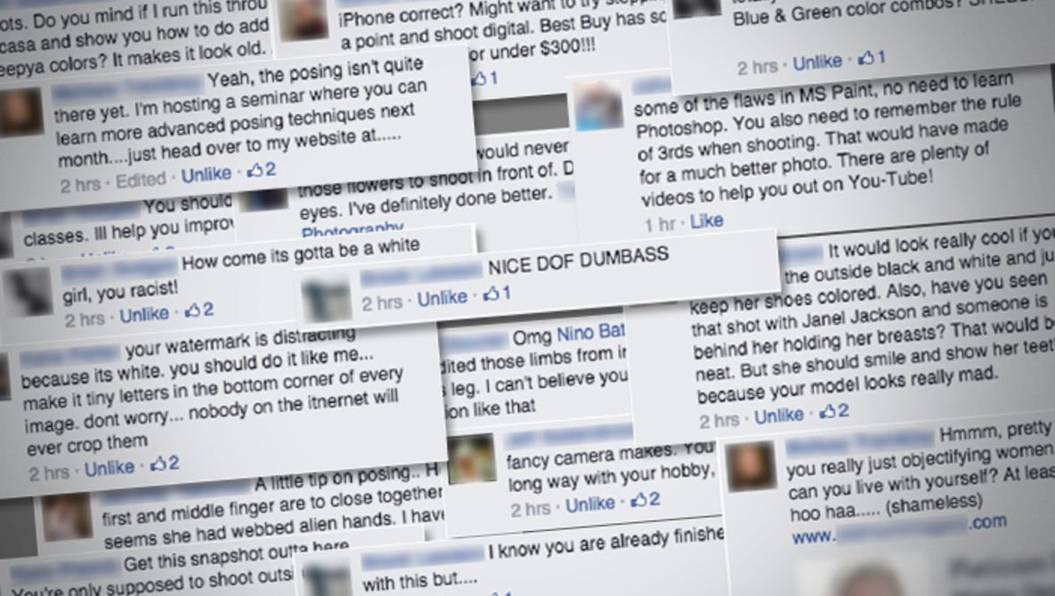
Background
•Freedom of speech
Expressing feelings and opinions
•Not strict Censorship/ Regulation for Online platform
Dirty words
Others have bad feeeling
Internet Bullying

Slide 4
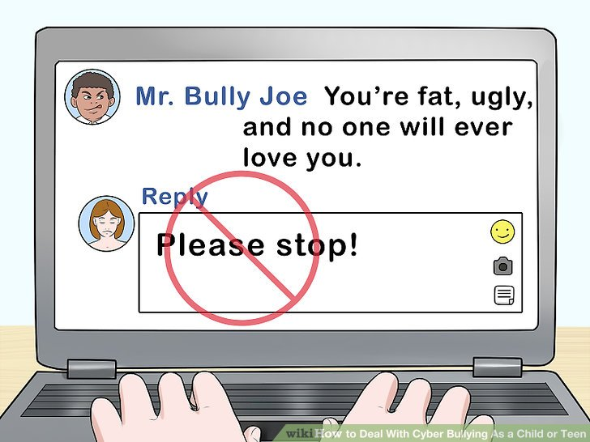
Aims
Improving online conversation
build a predictive model
find out the disrespectful or rude words
block or delete comments
prevent online bullying
Further application -- Product reviews
Relationship between comment and product quality
more dirty words means low quality?
Notes:
Create predictive model

Slide 5
Technical presentation
How we conduct data analysis?

Slide 6
Data Analytics Cycle
Phase 1: Data Collection & Assembly
toxic comment dataset
Phase 2: Data Preprocessing
Port Stemmer Algorithm
Lemmatization Algorithm
filter out digital
case folding
TF-IDF
Phase 3: Data Exploration & Visualization
Phase 4: Model Buliding
Decision Tree
Logistisic Regression
Naive Bayes
Phase 5: Model Evaluation

Slide 7
Data Collection & Assembly
Kaggle (https://www.kaggle.com/)
Toxic Comment Dataset
the Wikipedia Comments with labeled for different toxic behavior
around 150,000 records

Slide 8
Dataset - Comment with Labels
 | id | comment_text | severe_toxic | obscene | threat | insult | identity_hate
0 | 0000997932d777bf | Explanation\nWhy the edits made under my usern... | 0 | 0 | 0 | 0 | 0
1 | 000103f0d9cfb60f | D'aww! He matches this background colour I'm s... | 0 | 0 | 0 | 0 | 0
2 | 000113f07ec002fd | Hey man, I'm really not trying to edit war. It... | 0 | 0 | 0 | 0 | 0

Slide 9
Data Preprocessing
•Case Folding
•Filter out digital
•Remove Stop Word
•Lemmatization
•Porter stemmer Algorithm
•TF-IDF
Notes:
Lower case - > Case folding - letters to lowercase?
Removing stop words

Slide 10
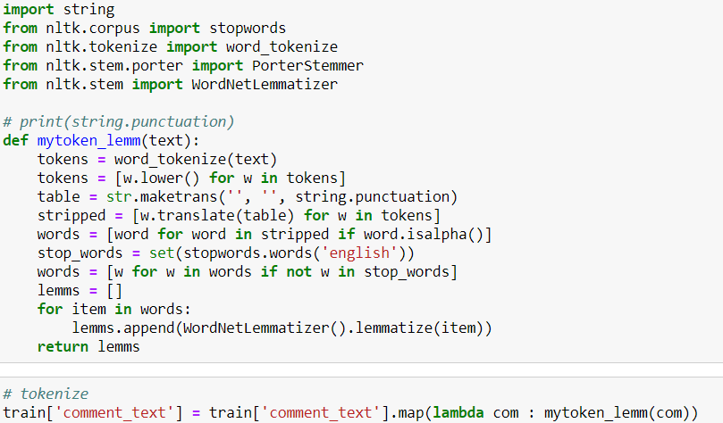
Data Proprocessing - Lemmatization
"Explanation\nWhy the edits made under my username Hardcore Metallica Fan were reverted? They weren't vandalisms, just closure on some GAs after I voted at New York Dolls FAC. And please don't remove the template from the talk page since I'm retired now.89.205.38.27"
eg.
explanation => explanation
edits => edit
don’t => ["do","n’t"]
were => be
went => go

Slide 11

Data Proprocessing - Porter Stemmer Algorithm
"Explanation\nWhy the edits made under my username Hardcore Metallica Fan were reverted? They weren't vandalisms, just closure on some GAs after I voted at New York Dolls FAC. And please don't remove the template from the talk page since I'm retired now.89.205.38.27"
eg.
explanation => explana
edits => edit
don’t => ["do","n’t"]
were => were

Slide 12
Data Proprocessing - TFIDF
"Explanation\nWhy the edits made under my username Hardcore Metallica Fan were reverted? They weren't vandalisms, just closure on some GAs after I voted at New York Dolls FAC. And please don't remove the template from the talk page since I'm retired now.89.205.38.27"
['explana', 'whi', 'the', 'edit', 'made', 'under', 'my', 'usernam', 'hardcor', 'metallica', 'fan', 'were', 'revert', '?', 'they', 'were', "n't", 'vandal', ',', 'just', 'closur', 'on', 'some', 'ga', 'after', 'I', 'vote', 'at', 'new', 'york', 'doll', 'fac', '.', 'and', 'pleas', 'do', "n't", 'remov', 'the', 'templat', 'from', 'the', 'talk', 'page', 'sinc', 'I', "'m", 'retir', 'now.89.205.38.27']

Slide 13
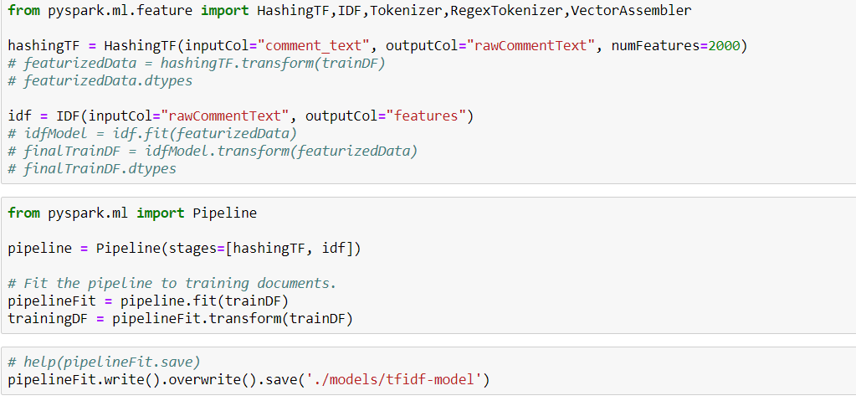

Slide 14
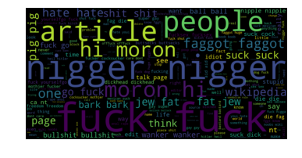
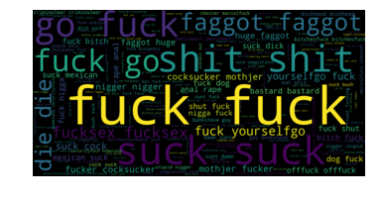
Data Exploration & Visualization
Toxic
Servere_Toxic

Slide 15
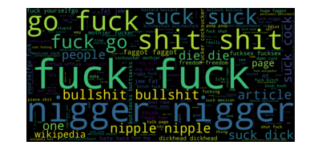
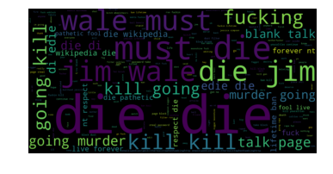
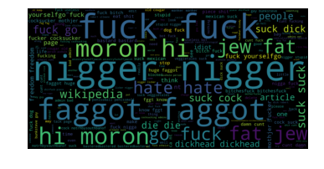
Data Exploration & Visualization
Obscene
Identity_hate
Threat
Insult

Slide 16

Parallel Computing Framework- Apache Sprak
Open Source Cluster Computing Framework
In-Memory Computing (RDD)
Automatic parallelization
Support HDFS
Support Cluster
Notes:
Stores the intermediate processing data in memory

Slide 17
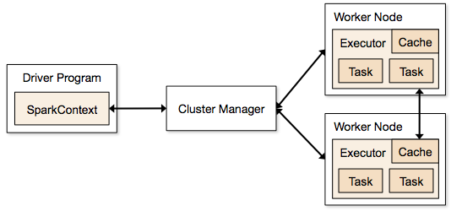
Parallel Computing Model - Spark Cluster

Slide 18
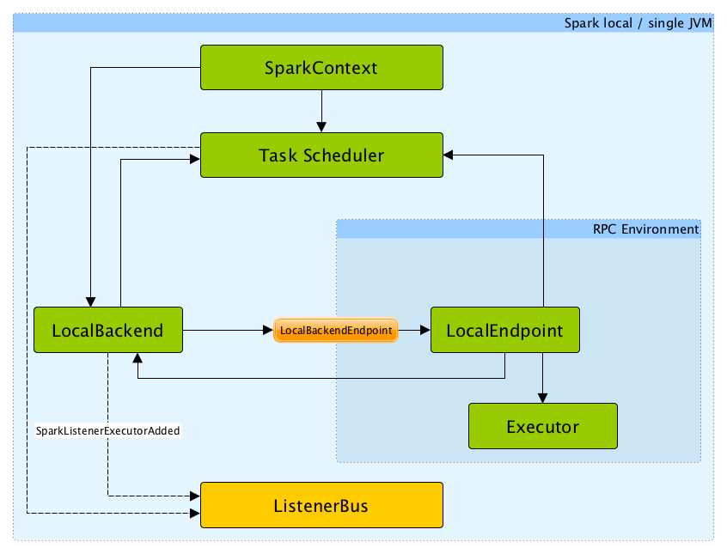
Parallel Computing Model
Spark local (pseudo-cluster)
https://jaceklaskowski.gitbooks.io/mastering-apache-spark/spark-local.html

Slide 19
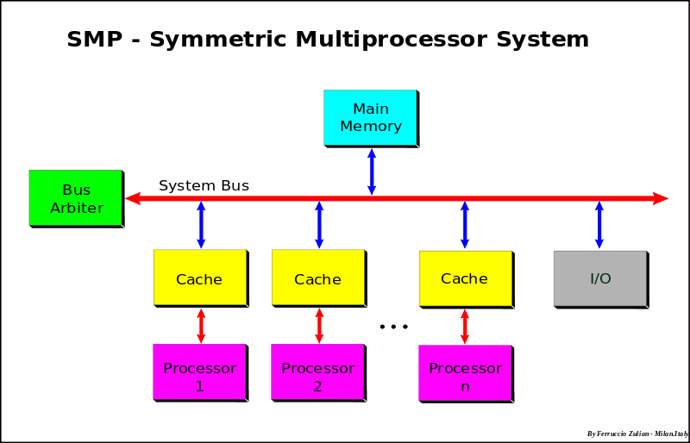
Parallel Computing Environment - Local Computer
Symmetric multiprocessor machines (SMP)
Mutiple Processor
One Piece of Memory
Equivalent privilege
https://en.wikipedia.org/wiki/Symmetric_multiprocessing
Notes:
Stores the intermediate processing data in memory

Slide 20
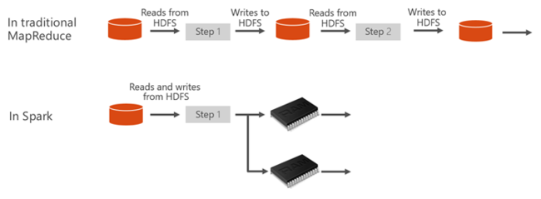

Memory Architectures - Sprak RDD
Resilient Distributed Datasets (RDD)
“Save intermediate date in RAM,
Not in Seconday Storage”
Notes:
Stores the intermediate processing data in memory

Slide 21
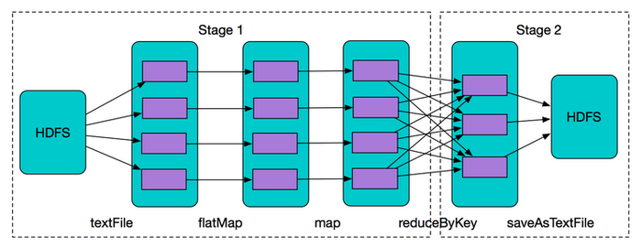
Notes:
Stores the intermediate processing data in memory

Slide 22
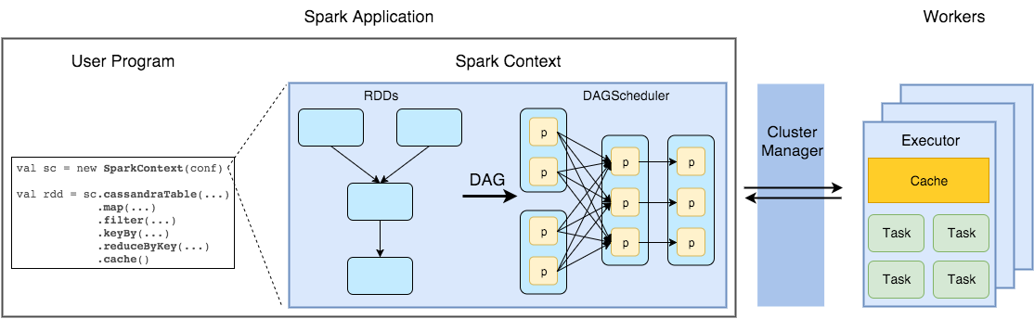
Notes:
Stores the intermediate processing data in memory

Slide 23
Memory Architectures
Memory architectures - UMA
Processor share memeory evently
CC - cache coherent
❌Synchronization overhead
❌Communications overhead
Share Memory Model - UMA
One global shared memory address
Data Locality

Slide 24
Model Building and Evaluation
LogisticRegression
Decision Tree
Naive Bayes

Slide 25
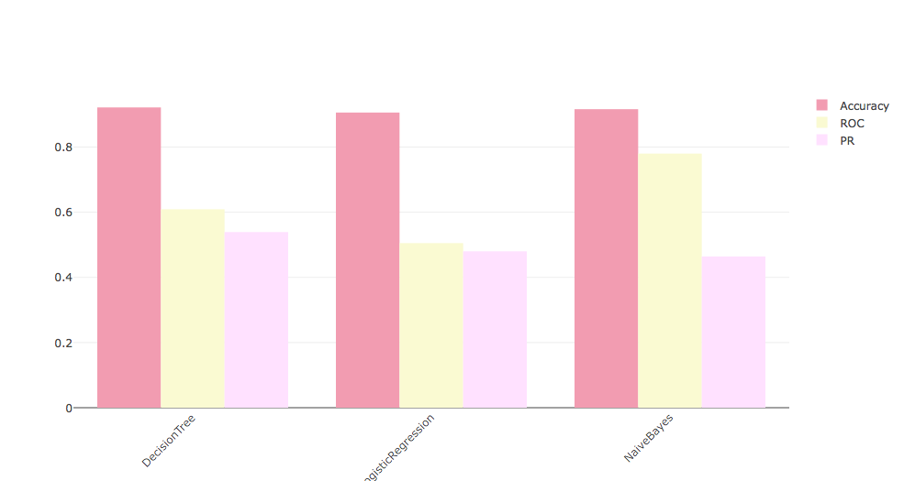
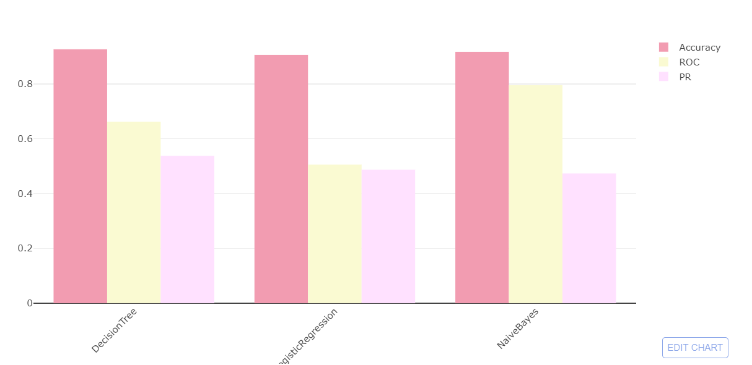
Model Building and Evaluation
Accuracy
Rceiver Operating Characteristic(ROC) Curve
Precision Recall(PR) Curve
Lammalization
Porter Stemming
Notes:
nb: computes the conditional probability distribution of each feature given each label

Slide 26
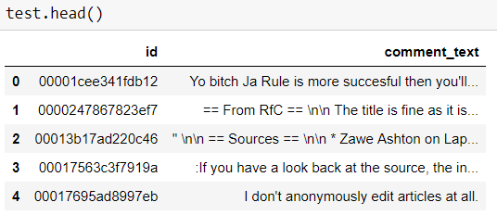
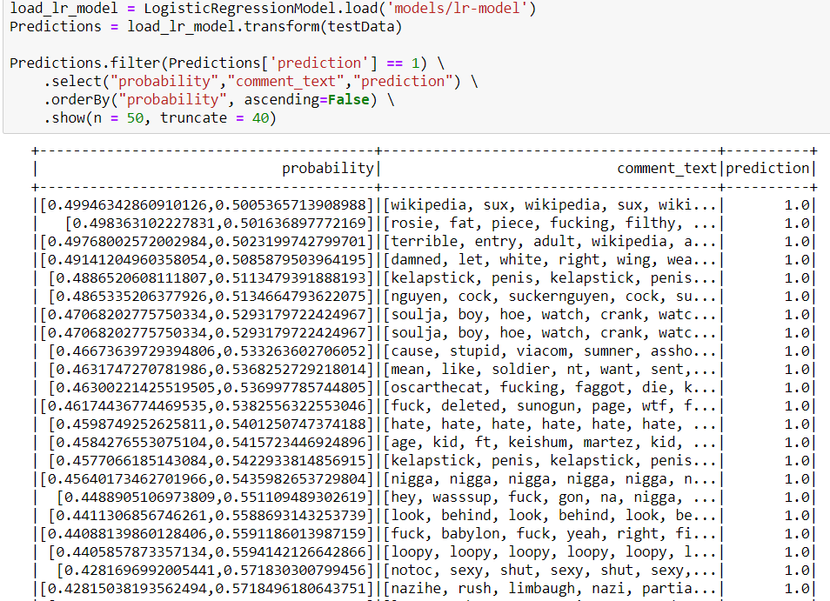
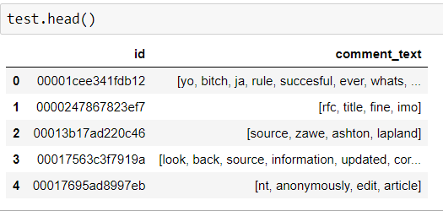

Slide 27
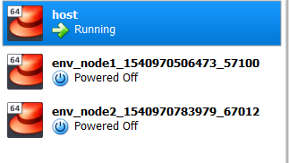
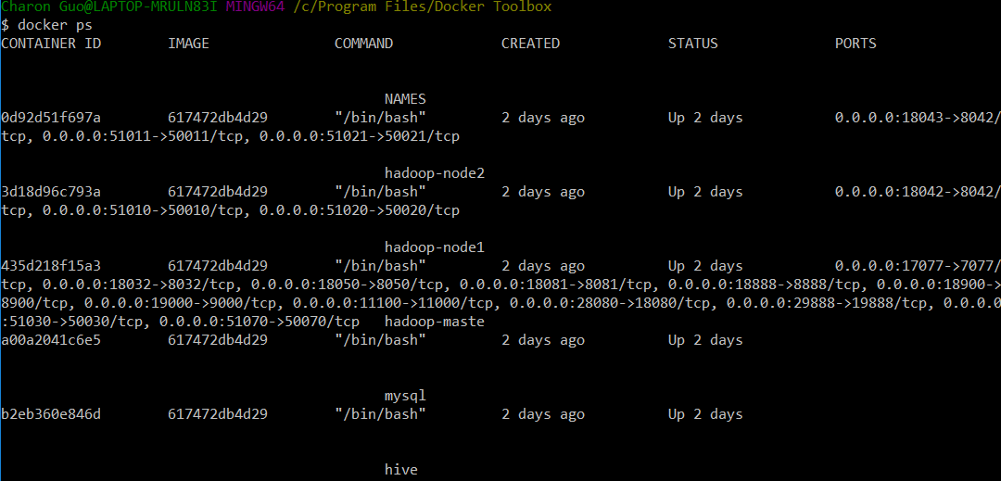
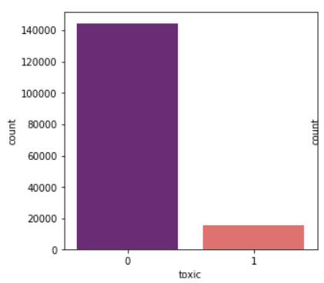
Further Improvement
Smote - Data Imbalance -> Receiver Operating Characteristic Curve(ROC) rate
Byte pair Encoding(BPE) - TFIDF improvement
Model Parameter tunning
Spark Cluster - Real Distributed Computing -> Random Forest
Spark Docker Images Cluster on Kubernetes

Slide 28
Q & A Section

